Slide 1

Sonar Rock vs Mine Prediction Game
A Machine Learning & Flask Web Application

Slide 2

Project Overview
This full-stack project combines machine learning with web development to create an interactive game that predicts whether underwater objects are rocks or mines using sonar signal data.
The system uses real machine learning models trained on sonar frequency patterns, delivering predictions through an engaging game interface with live scoring.

Slide 3






Why This Matters
Safety Critical
Manual Challenges
ML Automation
Wrong identification of underwater objects can cause serious accidents in naval operations and maritime navigation.
Underwater sonar signals are complex and difficult to interpret manually, requiring expert analysis.
Machine learning automates detection, providing fast, accurate predictions based on 60 frequency readings.

Slide 4
The Dataset & Technology Stack
Sonar Dataset
Core Technologies
60 numerical values per sample
Represents sonar signal frequency readings
Binary classification: Rock (1) or Mine (0)
Real-world sonar data patterns
Python & Flask for backend
HTML/CSS/JS for frontend
NumPy & Scikit-learn for ML
Pickle for model persistence
Render for cloud deployment

Slide 5
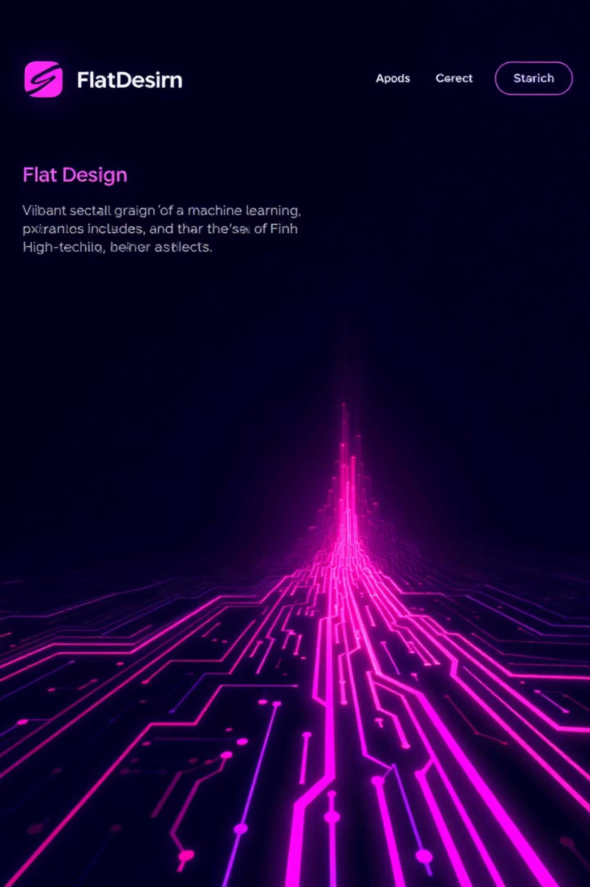
Machine Learning Architecture
01
Data Preprocessing
StandardScaler normalizes 60 sonar values for consistent model input
02
Model Training
Scikit-learn algorithms trained on labeled sonar data patterns
03
Model Persistence
Serialized as sonar_model.pkl and scaler.pkl
04
Real-time Prediction
Flask API processes sonar values and returns Rock/Mine classification

Slide 6
Game Logic & Interactive Features
Probability-Based Scoring
Interactive UI
The game generates sonar values with controlled probabilities to create realistic gameplay:
Users click "Scan Ocean" to generate predictions. Results display instantly with visual feedback and score tracking.
70% chance of generating rock patterns
30% chance of generating mine patterns
ML model validates all predictions
Scoring System
Players earn points by correctly identifying objects:
💎 Mine detected: +10 points
🪨 Rock detected: +0 points
Live score updates on screen

Slide 7



Flask API Endpoints
GET /
POST /scan
POST /reset
Home page serves the game interface with ocean-themed design and score display
Generates random sonar values, processes through ML model, returns prediction and updates score
Resets game score to zero, allowing players to start fresh

Slide 8




Challenges & Solutions
60-Value Input Handling
Problem: Managing 60 numerical inputs efficiently
Solution: NumPy arrays store values, StandardScaler ensures proper normalization
Git Merge Conflicts
Problem: Multiple developers working simultaneously
Solution: Manual conflict resolution and clear commit messages
Deployment Issues
Problem: Port binding conflicts on Render
Solution: Configured correct Flask port environment variables
UI-Backend Integration
Problem: Connecting frontend JavaScript with Flask endpoints
Solution: AJAX requests with JSON data exchange

Slide 9

Applications & Future Vision
Current Applications
Future Enhancements
Naval defense systems
Underwater exploration
Sonar-based detection
Educational ML demos
Game-based learning
Real sonar data input
Multiple difficulty levels
Multiplayer competition mode
Advanced ML models (deep learning)
Mobile app version

Slide 10

Thank You!
This project demonstrates the power of combining machine learning with web development to create engaging, real-world applications.
Key Takeaway: A complete full-stack ML project that delivers technical depth while maintaining user engagement through interactive gaming.

